Slide 1



HAP3 Automation: Generating a Synthetic Robot Program with digital fitting instructions, 3D models and cognitive robotics
Chair of
Automation
Fabian Jonen

Slide 2
What is a synthetic robot program?
Automated generation of a robot program with the formation of iterative loops depending on workspace and process data
Why synthetic robot programming?
Up to 70% faster robot programming compared to teach-in
Small robot applications with low cycle numbers become affordable
Robot programs can be updated automatically if workspace changes occur
Chair of
Automation
Fabian Jonen

Slide 3
Input
Digitized Fitting Instruction
For the knowledge of which steps to take
BOM (Bill of material) or asciiJT (not yet implemented)
For 3D Models
Databases
For Coordinates and skills
Absolute coordinates
Pick skills
Operation (Assembly) skills
Output
Robot Program in UR-SCRIPT format
The Program inherits for each assembly object (e.g. Bushing):
Pick-up skill
Pick-up poses
Safe path to target assembly pose
Assembly skill

Slide 4
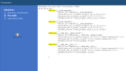
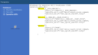
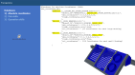

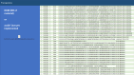
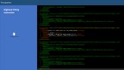

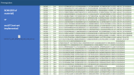
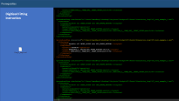
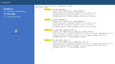
Overview
Input
Input
Function 01 get absolute coordinates
Get absolute coordinates of root objects in an assembly step like Front Case, Bushing Tray. Receive it from Database or look for it if coordinates are only rough.
Input
Function 02 use relation and look up in pick skill database
01_SRP_Cluster_Generator.py
For an assembly object (e.g. Bushing) look up the specific skill that is needed to pick up the object, that is stored in a database
Generates a cluster with required data for a robotic application of a specific assembly step of a Digitized Fitting instruction
Input
Function 03 get relative highway safe points from where robot can move to target coordinates
With the 3D models of objects in the robotic space a 3D-Grid is created with safe zones and restricted zones (Collision object is here)
02_SRP_Cluster_2_UR_Script.py
Input
Function 04 read BOM and extract relative coordinates
Converts the cluster to Universal Robots Script Language (UR Robot Controller can execute this program) The Program inherits for each assembly object (e.g. Bushing):
Pick-up skill
Pick-up poses
Safe path to target assembly pose
Assembly skill
For the assembly step receive relative coordinates of the parts that needs to be assembled (e.g. Bushings) -> absolute Root-Object coordinates + relative object coordinates = absolute Coordinates of assembly position
Function 05 depending on safe highway points create waypoints to reach target coordinates
With the start pose (Coordinates of Bushing in Tray) and the end pose (absolute Coordinates of assembly position) find a safe path through the 3D-Grid to reach the target (target is the assembly position with an offset of 3cm in –Z-axis)
Input
Function 06 use relation and look up in assembly skill database
“Relation”=Assembly object -> For the assembly object (e.g. Bushing) look up the specific skill that is needed for assembly, that is stored in a database
Robot
(click to finish presentation)

Slide 5
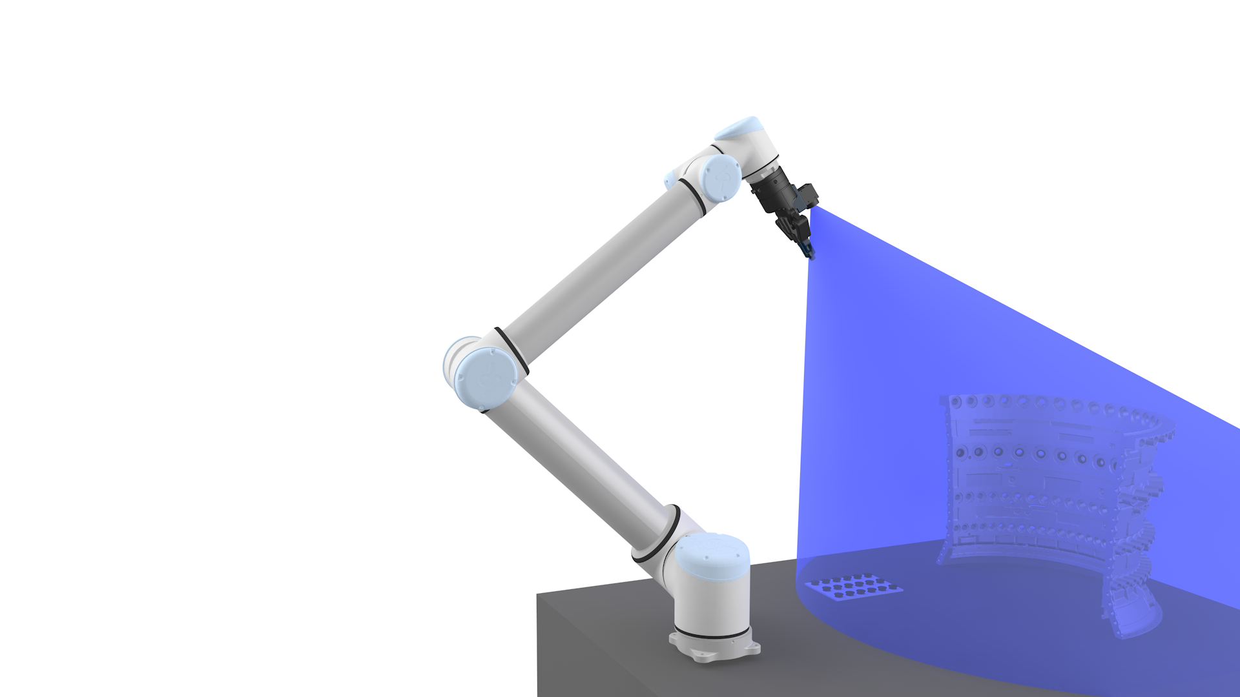
Functions
Function 01 get coordinates from opt1 opt2 opt3
#Function returns (1, [0.5, 0, 0, 0, 0, 0]) with Option-ID and absolute coordinates in robot base-Frame (if any)
#Option1: There are no fix coordinates, robot must use Object Detection to get the absolute coordinates of the objects
#Option2: Get fix coordinates from database
#Option3: Get rough coordintes from database to do OpenCV detection, Lets use this for demonstrator
#TODO Function that controlls the robot to seek for objects depending on option-ID
01_SRP_Cluster_Generator.py
Generates a cluster with required data for a robotic application of a specific assembly step of a Digitized Fitting instruction
Function 02 use relation and look up in pick skill database
Function 03 get relative highway safe points from where robot can move to target coordinates
Function 04 read BOM and extract relative coordinates
Function 05 depending on safe highway points create waypoints to reach target coordinates
Function 06 use relation and look up in assembly skill database

Slide 6
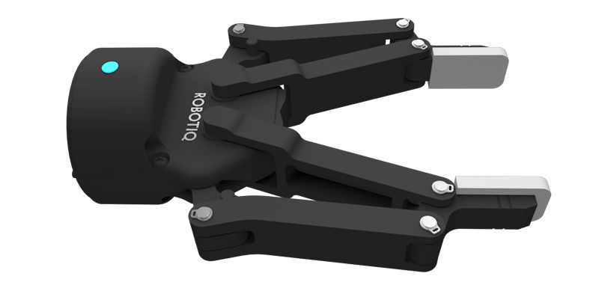

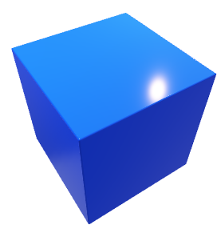
Functions
Function 01 get coordinates from opt1 opt2 opt3
Function 02 use relation and look up in pick skill database
#Will be a relative start and end position to the absolute pose of the object. Which is created in Unity by Immanuel.Horn@ferchau.de
#Function returns ([0, 0, 0.05, 0, 0, 0], [0, 0, 0.0, 0, 0, 0])-> Start and End Pose relative to origin of the object
01_SRP_Cluster_Generator.py
Generates a cluster with required data for a robotic application of a specific assembly step of a Digitized Fitting instruction
Function 03 get relative highway safe points from where robot can move to target coordinates
Function 04 read BOM and extract relative coordinates
Function 05 depending on safe highway points create waypoints to reach target coordinates
Function 06 use relation and look up in assembly skill database

Slide 7
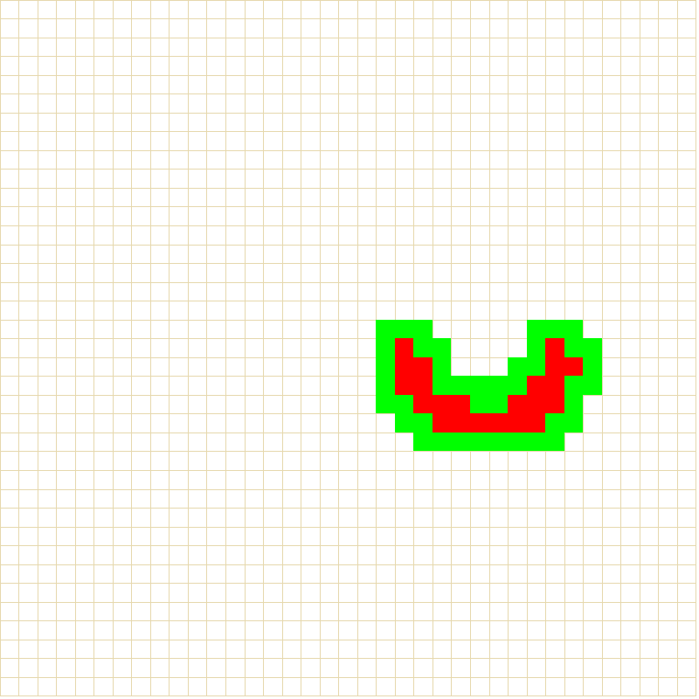
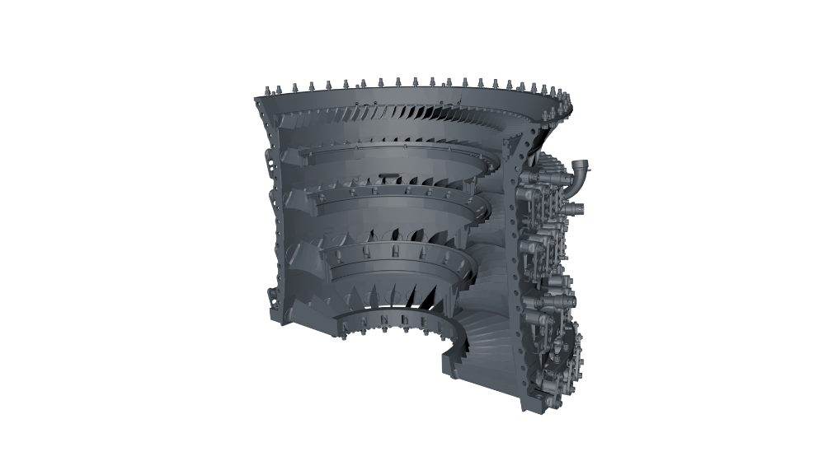
Functions
Function 01 get coordinates from opt1 opt2 opt3
Function 02 use relation and look up in pick skill database
Function 03 get relative highway safe points from where robot can move to target coordinates
01_SRP_Cluster_Generator.py
#In 3D workspace we have obstacles (pointclouds from BOM) where we must maneuver around.
#For each object in the robot workspace we extract subpart positions to find restricted area. with A* Algorithm we find routes which avoid these obstacles later
#Function returns a grid (maze)
#[ [[11],[12]]
# [[21],[22]] ]
#like
#[ [[rowID, colID, [x1[meters], y1[meters],x2[meters], y2[meters]], value=1/0 ],[rowID, colID, [x1[meters], y1[meters],x2[meters], y2[meters]], value=1/0 ]],
# [[rowID, colID, [x1[meters], y1[meters],x2[meters], y2[meters]], value=1/0 ],[rowID, colID, [x1[meters], y1[meters],x2[meters], y2[meters]], value=1/0 ]] ]
#value 1 = not safe, value 0 = safe, value 2 = safety distance
Generates a cluster with required data for a robotic application of a specific assembly step of a Digitized Fitting instruction
Function 04 read BOM and extract relative coordinates
Function 05 depending on safe highway points create waypoints to reach target coordinates
Function 06 use relation and look up in assembly skill database

Slide 8
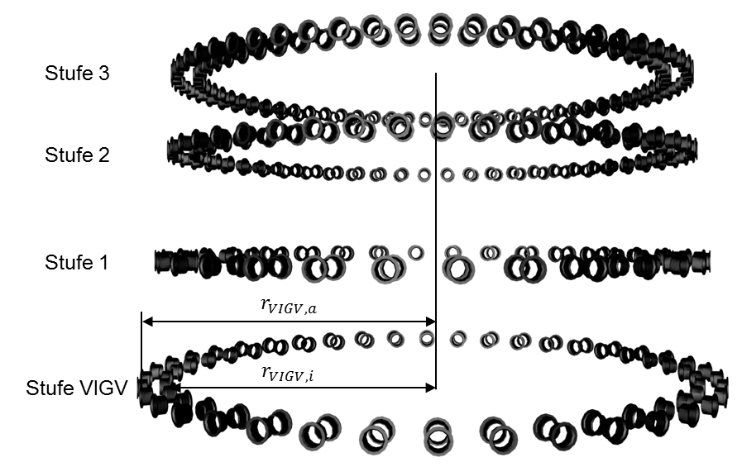
Functions
Function 01 get coordinates from opt1 opt2 opt3
Function 02 use relation and look up in pick skill database
Function 03 get relative highway safe points from where robot can move to target coordinates
01_SRP_Cluster_Generator.py
Function 04 read BOM and extract relative coordinates
Generates a cluster with required data for a robotic application of a specific assembly step of a Digitized Fitting instruction
#Function returns a list with robot friendly coordinates of the relative positions of "relation" objects (Objects to assemble) [[X,Y,Z,RX,RY,RZ],[X,Y,Z,RX,RY,RZ], ...]
Function 05 depending on safe highway points create waypoints to reach target coordinates
Function 06 use relation and look up in assembly skill database

Slide 9
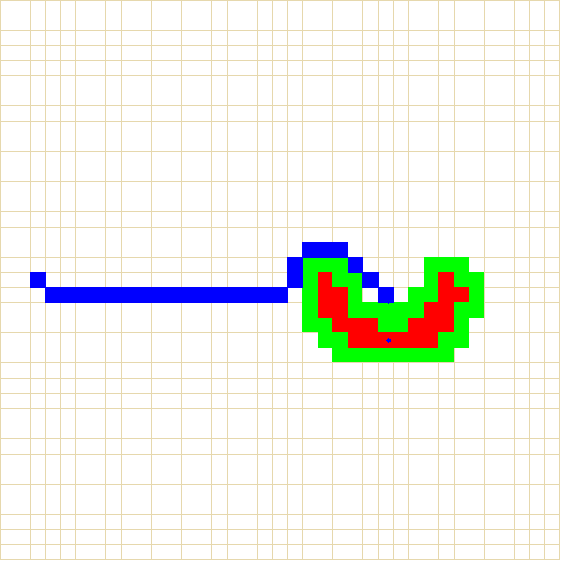
Functions
Function 01 get coordinates from opt1 opt2 opt3
Function 02 use relation and look up in pick skill database
Function 03 get relative highway safe points from where robot can move to target coordinates
01_SRP_Cluster_Generator.py
Function 04 read BOM and extract relative coordinates
Generates a cluster with required data for a robotic application of a specific assembly step of a Digitized Fitting instruction
Function 05 depending on safe highway points create waypoints to reach target coordinates
#With a startpose and an endpose we can obtain a safe path through the environment
#uses an A* (Astar) pathfinding algorithm in 2D which was upgraded to also work in 3D
#This function returns a path consisting of robotic waypoints in base frame for each relation
Function 06 use relation and look up in assembly skill database

Slide 10
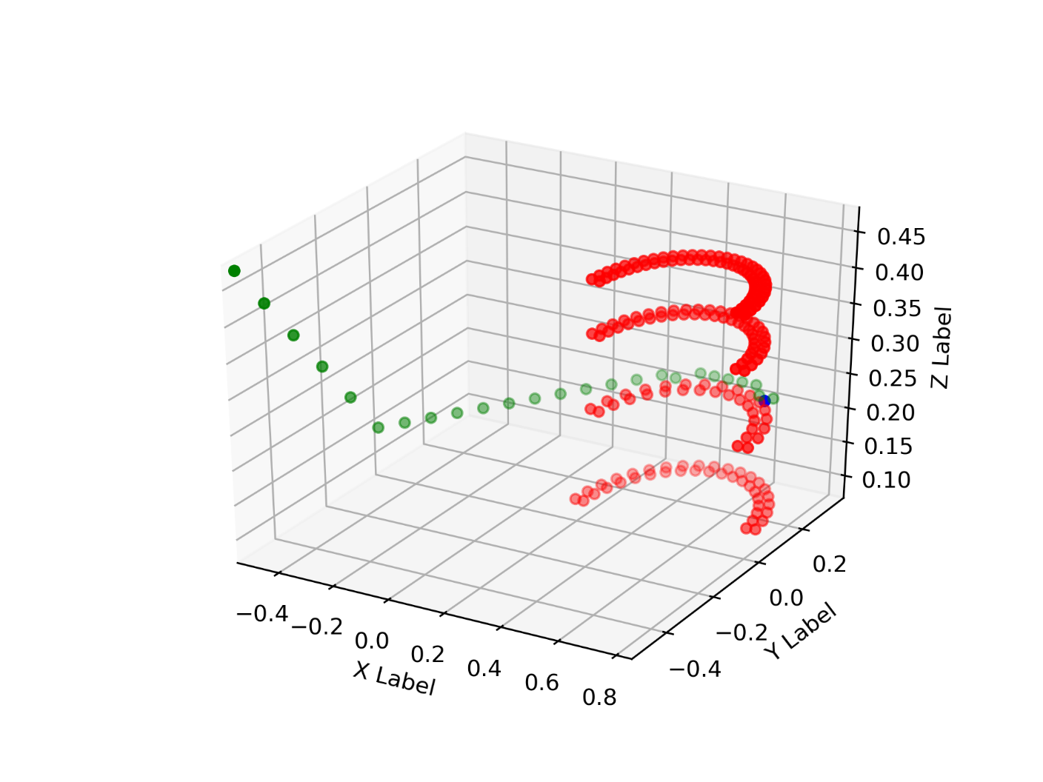
Functions
Function 01 get coordinates from opt1 opt2 opt3
Function 02 use relation and look up in pick skill database
Function 03 get relative highway safe points from where robot can move to target coordinates
01_SRP_Cluster_Generator.py
Function 04 read BOM and extract relative coordinates
Generates a cluster with required data for a robotic application of a specific assembly step of a Digitized Fitting instruction
Function 05 depending on safe highway points create waypoints to reach target coordinates
#With a startpose and an endpose we can obtain a safe path through the environment
#uses an A* (Astar) pathfinding algorithm in 2D which was upgraded to also work in 3D
#This function returns a path consisting of robotic waypoints in base frame for each relation
Function 06 use relation and look up in assembly skill database

Slide 11
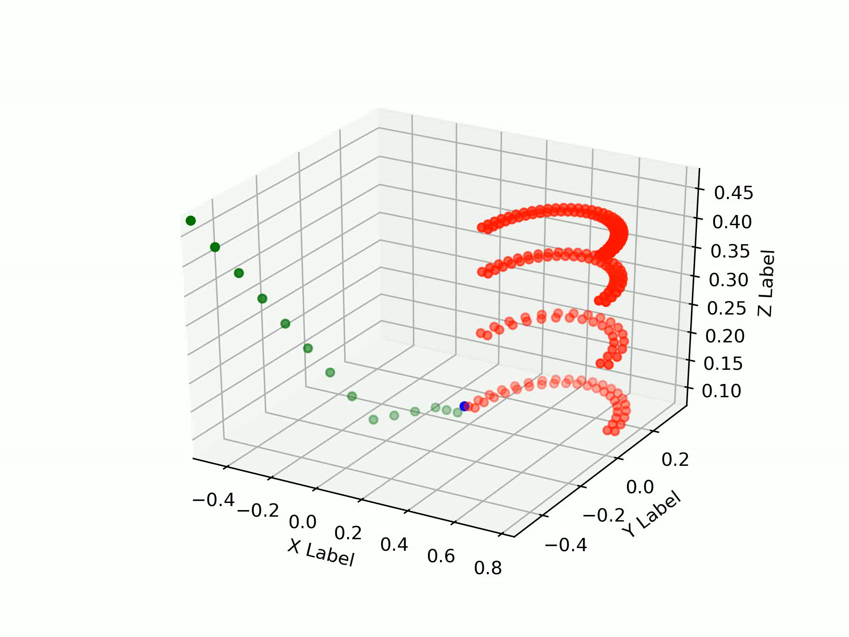
Functions
Function 01 get coordinates from opt1 opt2 opt3
Function 02 use relation and look up in pick skill database
Function 03 get relative highway safe points from where robot can move to target coordinates
01_SRP_Cluster_Generator.py
Function 04 read BOM and extract relative coordinates
Generates a cluster with required data for a robotic application of a specific assembly step of a Digitized Fitting instruction
Function 05 depending on safe highway points create waypoints to reach target coordinates
#With a startpose and an endpose we can obtain a safe path through the environment
#uses an A* (Astar) pathfinding algorithm in 2D which was upgraded to also work in 3D
#This function returns a path consisting of robotic waypoints in base frame for each relation
Function 06 use relation and look up in assembly skill database

Slide 12
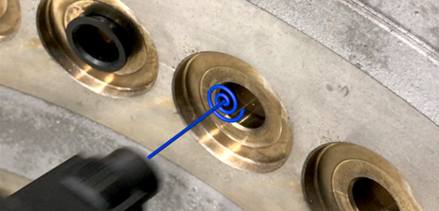
Functions
Function 01 get coordinates from opt1 opt2 opt3
Function 02 use relation and look up in pick skill database
Function 03 get relative highway safe points from where robot can move to target coordinates
01_SRP_Cluster_Generator.py
Function 04 read BOM and extract relative coordinates
Generates a cluster with required data for a robotic application of a specific assembly step of a Digitized Fitting instruction
Function 05 depending on safe highway points create waypoints to reach target coordinates
Function 06 use relation and look up in assembly skill database
#The function returns Universal Robots Script Code of a skill, which beforehand has to be programmed by an expert
#the default is spiral search (suits 80% of the applications)

Slide 13
The final synthetic robot program
##SCRIPT FOR Assemble all BUSH_BEARING onto HPC_FRONT_BOTTOM.
##Handling FW51530_D__BUSH_BEARING;0;92: Number 1
#Linear Pick Pose
movej(p[0.012000,-0.532000,0.050000,0.000000,0.000000,0.000000]) #Linear Pick Pose
#linear Move
movel(p[0.012000,-0.532000,0.000000,0.000000,0.000000,0.000000]) #Final Pick Pose
GRIPPER_ACTION.script
#back to Linear Pick Pose
movej(p[0.012000,-0.532000,0.050000,0.000000,0.000000,0.000000]) #Linear Pick Pose
#Safe move to pre-target position
movej(p[-0.475000,-0.475000,0.575000,2.133439,0.009086,2.124315]) #pose on a safe path
movej(p[-0.325000,-0.325000,0.425000,2.133439,0.009086,2.124315]) #pose on a safe path
movej(p[-0.175000,-0.175000,0.425000,2.133439,0.009086,2.124315]) #pose on a safe path
movej(p[-0.025000,-0.025000,0.425000,2.133439,0.009086,2.124315]) #pose on a safe path
movej(p[0.125000,-0.025000,0.425000,2.133439,0.009086,2.124315]) #pose on a safe path
#moving to a linear position before target position
movej(pose_trans(p[0.228125,0.024085,0.410535,2.133439,0.009086,2.124315],p[0,0,-0.03,0,0,0])) #pose before insertion
#Perform the operation Skill
exec_spiral_searchV7.script
movel(pose_trans(p[0.228125,0.024085,0.410535,2.133439,0.009086,2.124315],p[0,0,-0.03,0,0,0])) #back off linear after insertion
#Safe move back to pick-up position
movej(p[0.125000,-0.025000,0.425000,2.133439,0.009086,2.124315]) #pose on a safe path (reverse)
movej(p[-0.025000,-0.025000,0.425000,2.133439,0.009086,2.124315]) #pose on a safe path (reverse)
movej(p[-0.175000,-0.175000,0.425000,2.133439,0.009086,2.124315]) #pose on a safe path (reverse)
movej(p[-0.325000,-0.325000,0.425000,2.133439,0.009086,2.124315]) #pose on a safe path (reverse)
movej(p[-0.475000,-0.475000,0.575000,2.133439,0.009086,2.124315]) #pose on a safe path (reverse)
#
#
#
##Handling FW51530_D__BUSH_BEARING;0;92: Number 2
#Linear Pick Pose
movej(p[0.012000,-0.510000,0.050000,0.000000,0.000000,0.000000]) #Linear Pick Pose
#linear MoveC
…
…
01_SRP_Cluster_Generator.py
Generates a cluster with required data for a robotic application of a specific assembly step of a Digitized Fitting instruction
02_SRP_Cluster_2_UR_Script.py
Converts the cluster to Universal Robots Script Language (UR Robot Controller can execute this program) The Program inherits for each assembly object (e.g. Bushing):
Pick-up skill
Pick-up poses
Safe path to target assembly pose
Assembly skill
Robot
(click to finish presentation)

Slide 14

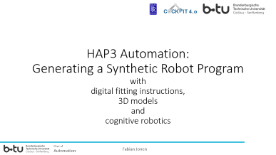
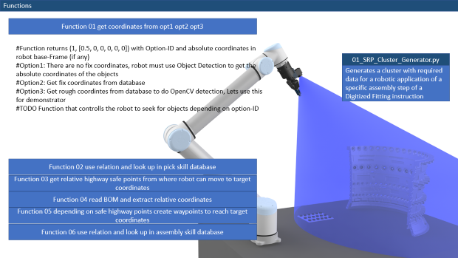


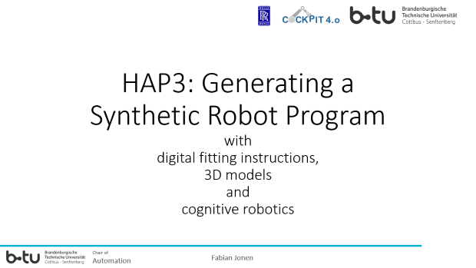
Thank you for your attention
Chair of
Automation
Fabian Jonen

Slide 15
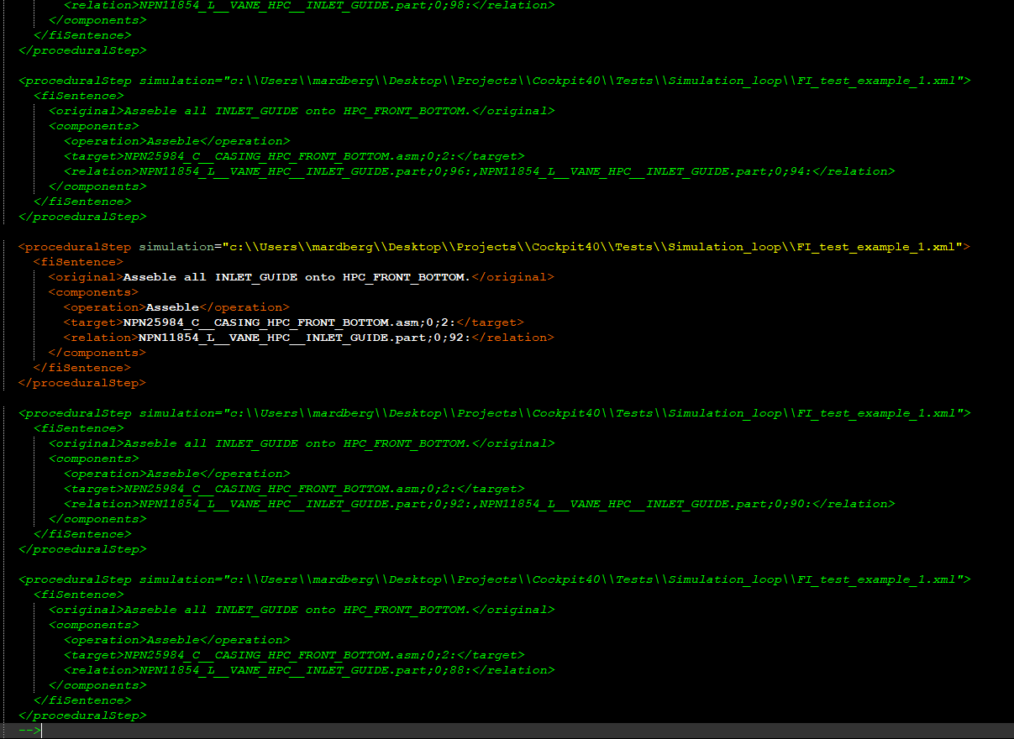
Prerequisites
Digitized Fitting Instruction

Slide 16
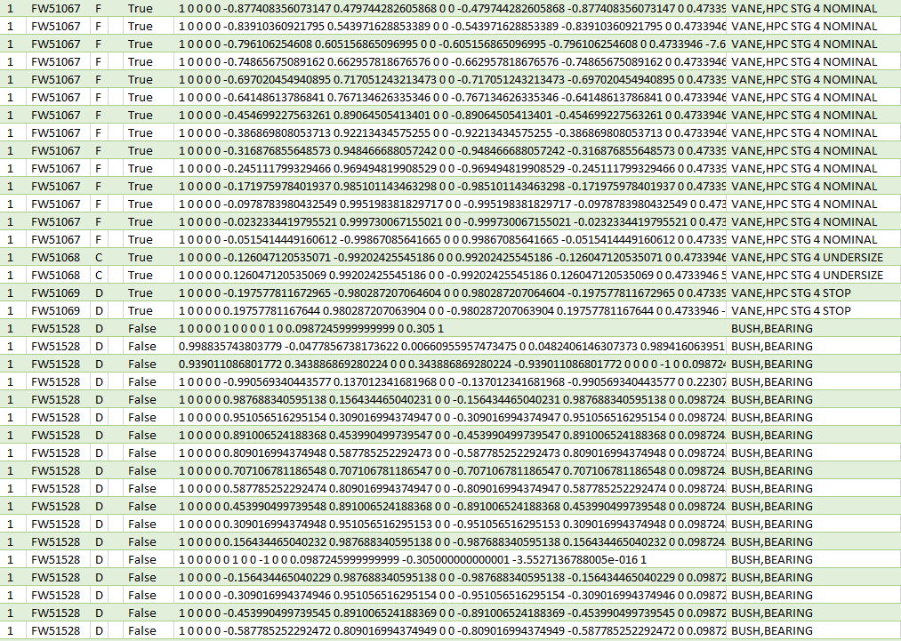
Prerequisites
BOM (Bill of material)
or
asciiJT (not yet implemented

Slide 17
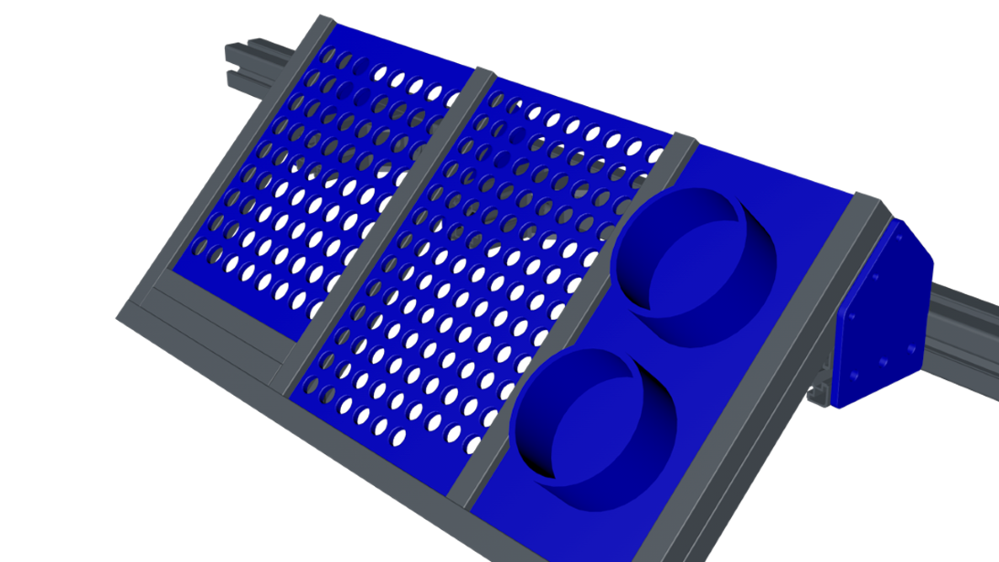

Prerequisites
#Database for absolute Coordinates (JSON)
abs_coordinate_db={
"NPN25984_C__CASING_HPC_FRONT_BOTTOM.asm;0;2:":{
"Object_ID":"NPN25984_C__CASING_HPC_FRONT_BOTTOM.asm;0;2:",
"abs_coordinates":[0.5,0,0,0,0,0],
"rough_coordinates_only":True
},
"FW51528_D__BUSH_BEARING;0;92:":{
"Object_ID":"ROB00001_BUSHING_LARGE_TRAY",
"abs_coordinates":[-0.2,-0.4,0,0,0,0],
"rough_coordinates_only":True,
"rel_coordinates" : [72 Coordinates for each large Bushing]
},
"FW51530_D__BUSH_BEARING;0;92:":{
"Object_ID":"ROB00002_BUSHING_SMALL_TRAY",
"abs_coordinates":[0.1,-0.4,0,0,0,0],
"rough_coordinates_only":True,
"rel_coordinates" : [114 Coordinates for each small Bushing]
}
}
Databases
Absolute coordinates
Pick skills
Operation skills

Slide 18
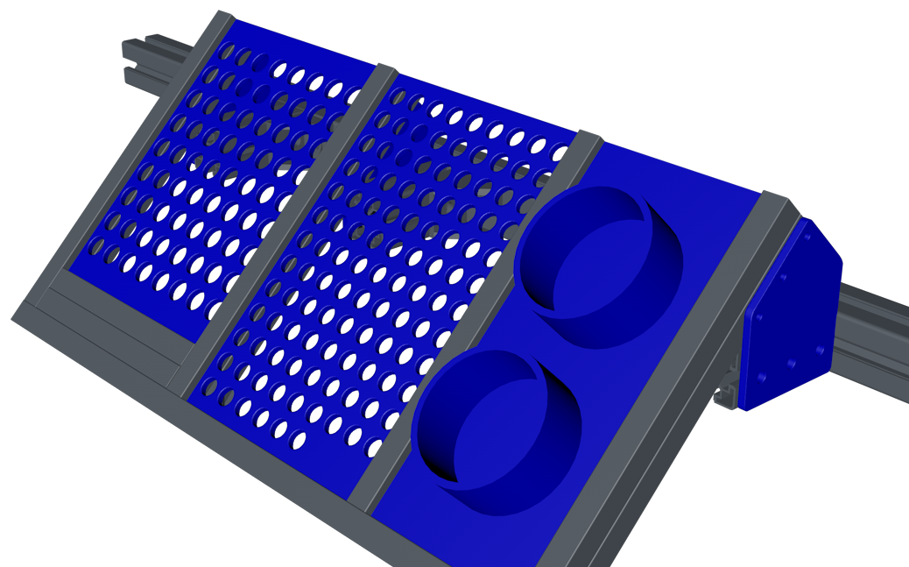

Slide 19
Prerequisites
#Database for pick skill Coordinates (JSON)
pick_skill_db={
"FW51528_D__BUSH_BEARING":{
"Object_ID":"FW51528_D__BUSH_BEARING",
"start_pose_rel_to_object_origin":[0,0,0.05,0,0,0],
"end_pose_rel_to_object_origin":[0,0,0.0,0,0,0],
"gripper_action":"open_gripper_from_0_to_11.script"
},
"FW51530_D__BUSH_BEARING":{
"Object_ID":"FW51530_D__BUSH_BEARING",
"start_pose_rel_to_object_origin":[0,0,0.05,0,0,0],
"end_pose_rel_to_object_origin":[0,0,0.0,0,0,0],
"gripper_action":"open_gripper_from_0_to_13.script"
},
"NPN11854_L__VANE_HPC__INLET_GUIDE":{
"Object_ID":"NPN11854_L__VANE_HPC__INLET_GUIDE",
"start_pose_rel_to_object_origin":[0,0.05,-0.07,math.radians(90),0,0],
"end_pose_rel_to_object_origin":[0,0,0.0,math.radians(90),0,0],
"gripper_action":"close_gripper.script"
},
"NPN11855_L__VANE_HPC__STG_1":{
"Object_ID":"NPN11855_L__VANE_HPC__STG_1",
"start_pose_rel_to_object_origin":[0,0.05,-0.07,math.radians(90),0,0],
"end_pose_rel_to_object_origin":[0,0,0.0,math.radians(90),0,0],
"gripper_action":"close_gripper.script"
},
…
}
Databases
Absolute coordinates
Pick skills
Operation skills

Slide 20
Prerequisites
#Database for operation skill Coordinates (JSON)
operation_skill_db={
"FW51528_D__BUSH_BEARING":{
"Object_ID":"FW51528_D__BUSH_BEARING",
"operation_skill_code":spiral_search_script_command,
"operation_skill":"exec_spiral_searchV7.script"
},
"NPN11854_L__VANE_HPC__INLET_GUIDE":{
"Object_ID":"NPN11854_L__VANE_HPC__INLET_GUIDE",
"operation_skill_code":spiral_search_script_command,
"operation_skill":"exec_spiral_searchV7.script"
},
"DEFAULT":{
"Object_ID":"NONE",
"operation_skill_code":spiral_search_script_command,
"operation_skill":"exec_spiral_searchV7.script"
}
}
Databases
Absolute coordinates
Pick skills
Operation skills

